Slide 1
NVL AX/AM RVP HSDES BKM for RVP Delta PRD Collection
WW34’25

Slide 2
How to Get access to HSD-ES
Link to permissions help: goto/e2e.perms
Architects should request access for the “E2E-Platform Requirement Author” entitlement in AGS. This will grant permissions to all the appropriate subjects in Client_Platf Tenant.
Use the following instructions to request access:
Go to https://ags.intel.com/identityiq/home.jsf
Click on submit request for self
Search for the role you are requesting access for- In this case - E2E-Platform Requirement Author
Click on the tick mark
Add the required “Justification”
Click on “submit”

Slide 3
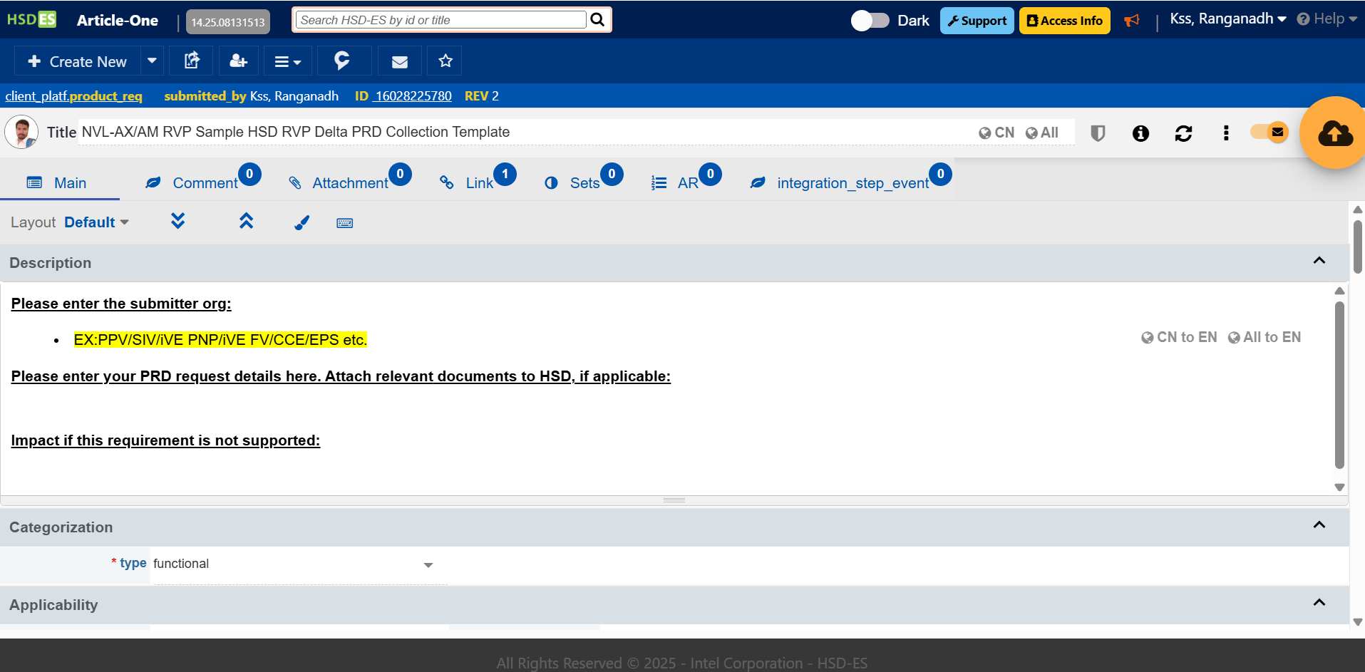
Step1: Open Chrome Browser (Do not use IE) Step2: Enter below URL in Chrome Browser → https://hsdes.intel.com/appstore/article-one/#/article/16028225780 (Note: Please do not modify this HSD as this is a template/sample HSD) Below page will open:
RVP PRD collection HSD-ES Process step (1,2 of 9)

Slide 4
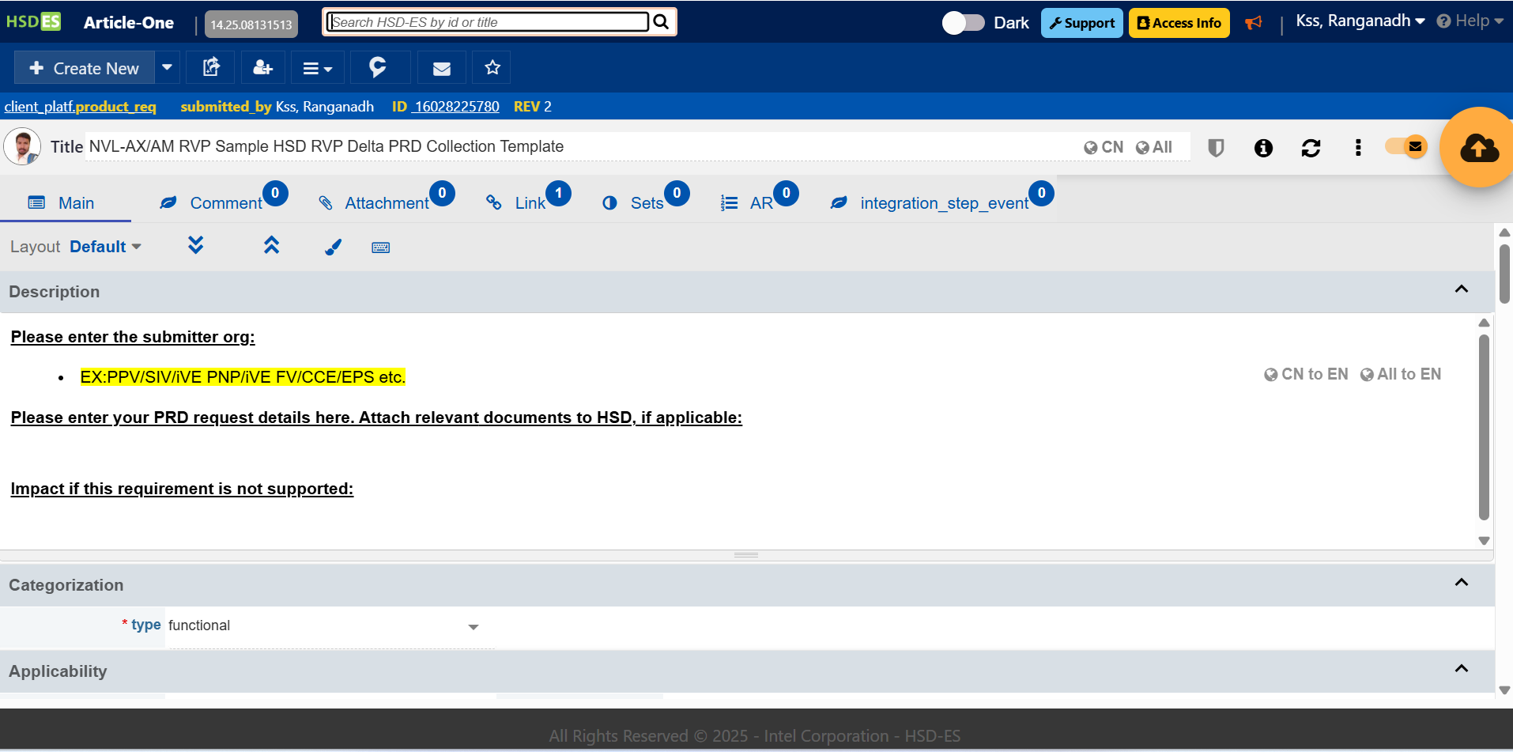
Step3: Click on highlighted arrow to create a new article
RVP PRD collection HSD-ES Process step (3 of 9)

Slide 5
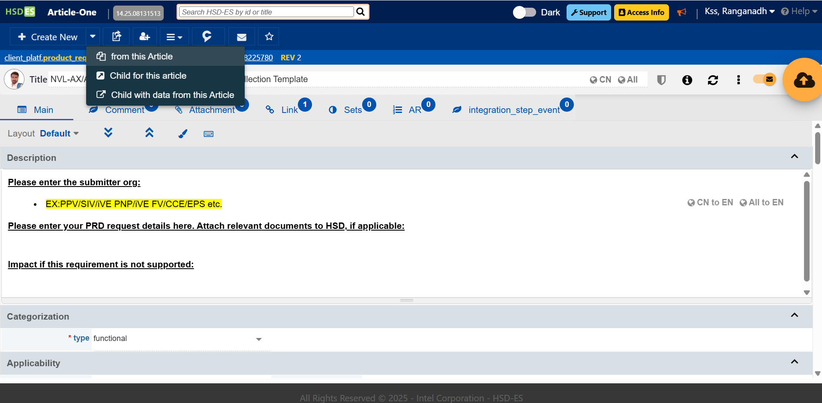
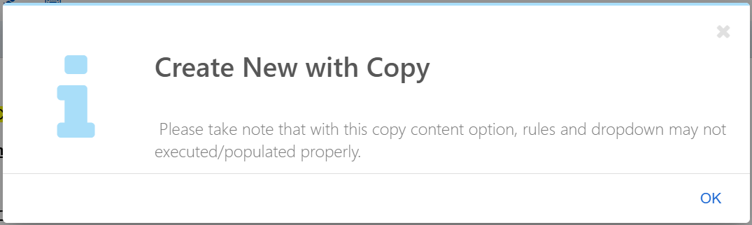
Step4: Click on “from this Article” so that new HSD-ES page will be created from template
RVP PRD collection HSD-ES Process step (4 of 9)
1
2
Click on “OK”

Slide 6

Step5: New Tab will open in Chrome Browser with new HSD-ES Article for PRD requirement (with new HSD-ES)
RVP PRD collection HSD-ES Process step (5 of 9)

Slide 7
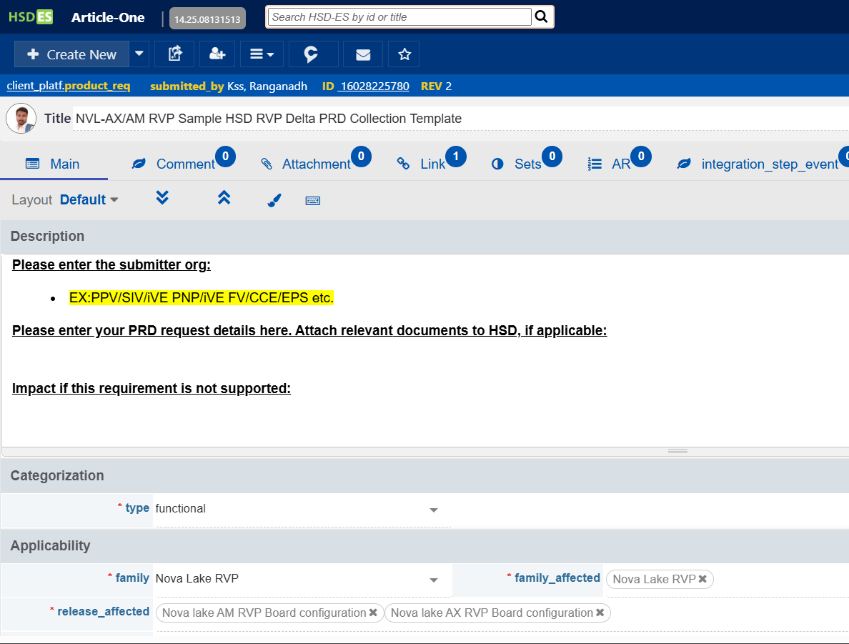
Step6: Fill in below details while providing PRD requirement
RVP PRD collection HSD-ES Process step (6 cont… of 9)
Title→ Enter title of PRD requirement with NVL-AX/AM:
Submitter → Enter the submitter or function org
Details → Enter description of PRD requirements
Impact if this requirement is not supported → Enter impact if this request not supported.
Release affected → Enter the same as shown here
a.
b.
c.
d.
e.

Slide 8
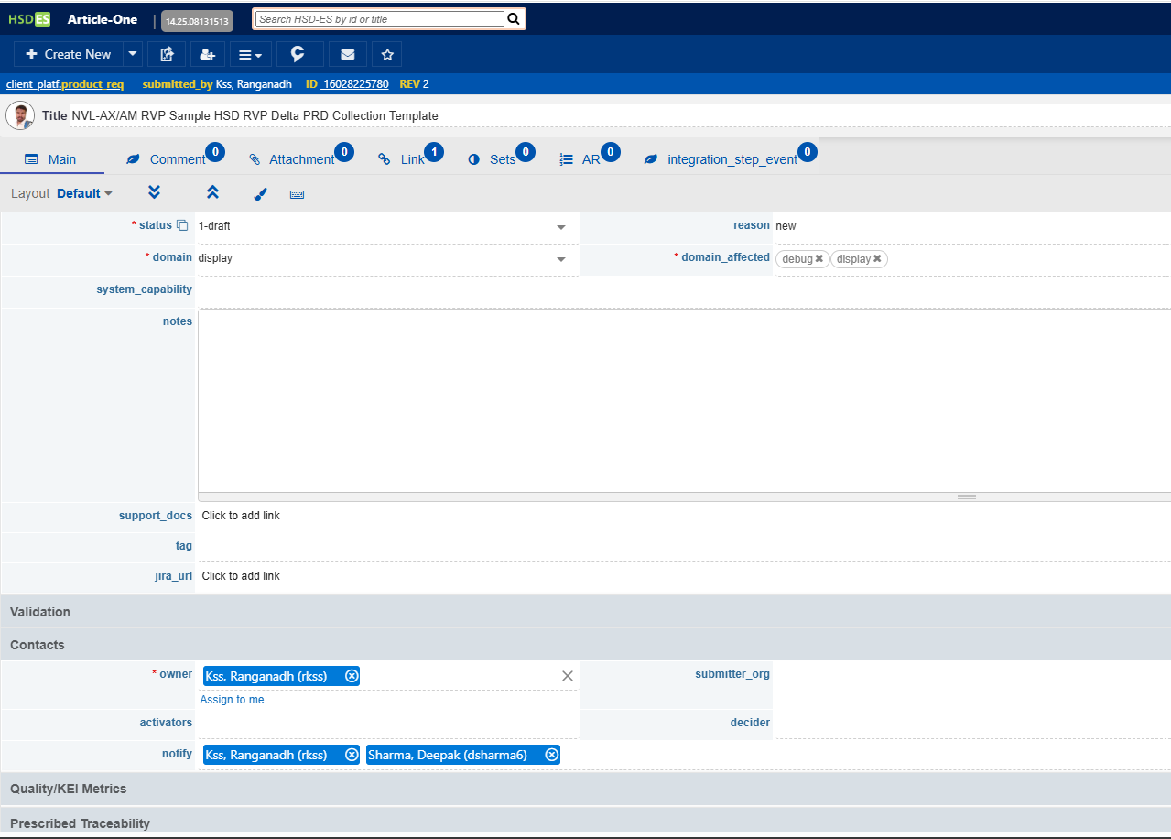
Step6: Fill in below details while providing PRD requirement
RVP PRD collection HSD-ES Process step (6 cont… of 9)
Status → Keep the same status as “1-draft”
Domain → Enter requirement domain (e.g. AUDIO, Debug, storage etc)
Domain_affected → Enter domain_affected
Notes → if required, enter more details here
Notify → Add mailing list who should get notification on update of this requirement based on the name list as shown here
f.
g.
h.
i.
j.
Please do not change Owner Contact here.

Slide 9
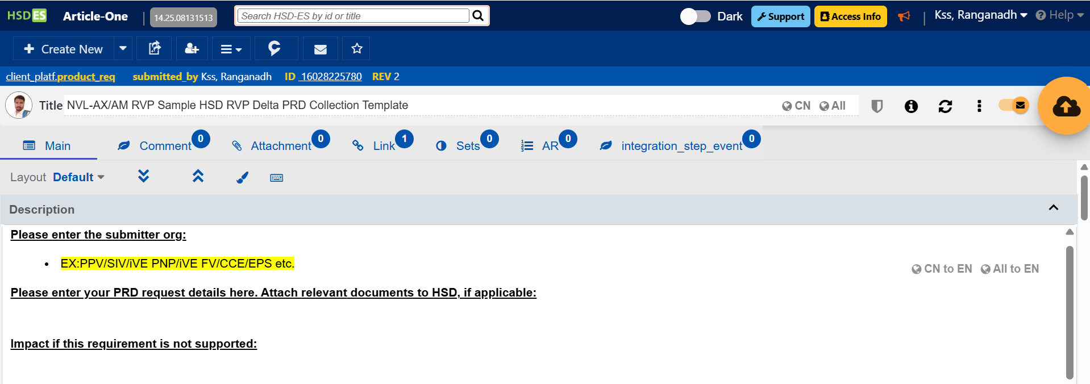
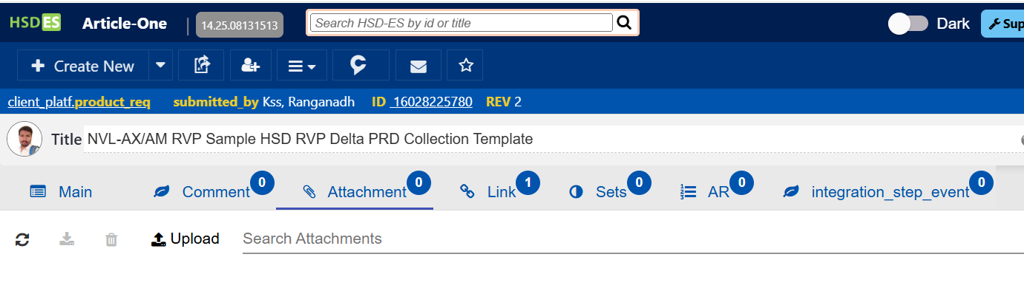
Step7: To attach any reference document during PRD submission, click on below icon (optional)
RVP PRD collection HSD-ES Process step (7 of 9)
1
2

Slide 10
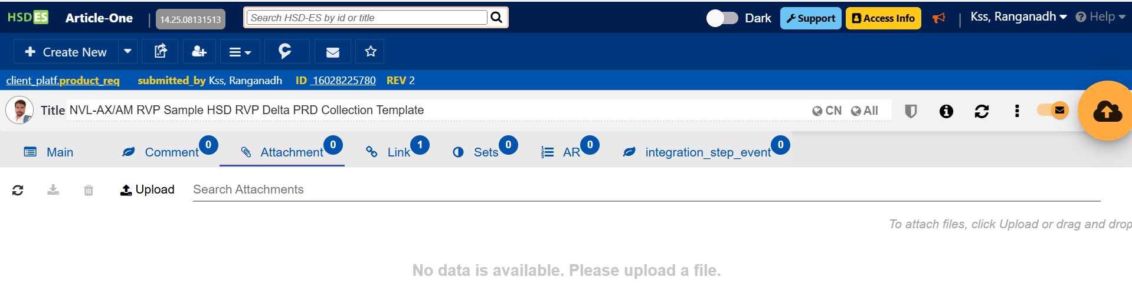
Step8: Click on icon to “save” the content
RVP PRD collection HSD-ES Process step (8, 9 of 9)
Step9: Repeat step2-8 to submit another PRD requirement.

